Slide 1
Fully connected layer

Slide 2
Fully connected layer
100 x 8192
...
100 x
[512x4x4]

Slide 3
Fully connected layer
100 x 8192
...
100 x
[512x4x4]
output =
output.view(output.size(0),-1)
100
나머지

Slide 4
Fully connected layer
100 x 8192
8192 x 10
fc = nn.Linear(8192,10) # 선언
output = fc(output) # 사용
*

Slide 5
Fully connected layer
100 x 8192
8192 x 10
100 x 10
=
*

Slide 6
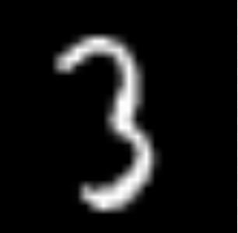


Fully connected layer
0 1 2 3 4 5 6 7 8 9
-1.5 | -55.2 | 10.2 | 78.3 | 3.5 | 8.4 | 2.1 | -3.4 | 21.9 | 0.7
-1.1 | -5.2 | 8.1 | 2.2 | -13.9 | 145.4 | 10.7 | -8.1 | -12.3 | 8.2
0
1
2
3

